Slide 1
GMM and K-Means clustering
Data Science Assignment 5
February 23, 2022
Daksh Patel

Slide 2
GMM
K-means
Soft Clustering
Cluster May Overlap with another cluster
Probability for data point to be part of cluster is
[0,1]
Hard Clustering
Cluster Can’t Overlap with another cluster
Probability for data point to be part of cluster is
{0,1}

Slide 3
Gaussian Mixture Model
1 - Decide number of clusters (Elbow Method)
2 - Initialize randomly placed Gaussians {(μ₁,σ₁²),(μ₂,σ₂²),.....(μ_{n},σ_{n}²)} and for each point find the probability of being in individual cluster. [0,1]
3 - Adjust (μ₁,σ₁²),(μ₂,σ₂²),.....(μ_{n},σ_{n}²) to fit data points assigned to them
4 - Keep iterating until convergence.

Slide 4
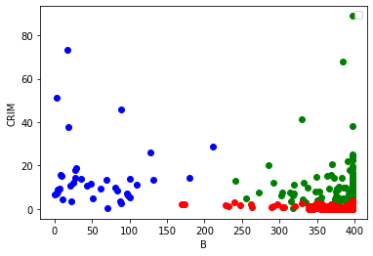
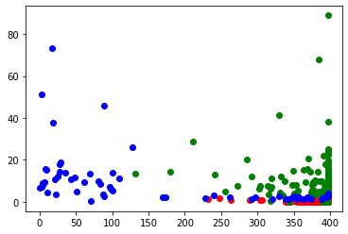
K-means GMM
pandas, numpy,
matplotlib, sklearn.cluster
pandas, numpy,
matplotlib, sklearn.mixture

Slide 5
Thank You

